Slide 1
Industrial Training/ Internship
Prathamesh Patil
20UCS102

Slide 2
Company Name
Acmegrade

Slide 3
About the company
Acmegrade is a free education program focused on underrepresented communities that helps adult learners, high school and university students, and faculty develop valuable new skills and access career opportunities.
The program includes an online platform complemented by customized practical learning experiences that aim to respond to learners’ needs as they progress through their education and career journeys. This effort is in collaboration with a network of world-class education partners, including public high schools, nonprofit organizations, governments, and corporations.

Slide 4
Tools Used
Operating System : Windows
Coding Language : Python
Editor : Jupyter Notebook
Libraries used : Numpy, Pandas, Matplotlib

Slide 5
Working Methodology
Acmegrade provides a mentor for an 8-week internship. For the first 4-weeks, they provided the courses that we learned and the next 4 weeks were the project development phase. The courses provided by them were based on Pyhon Programming.
The project development phase was of 4 weeks, in which, I use to complete a sub-task of project and the mentor would check the weekly updates on the project and solve issues if any.

Slide 6
Project Name
Movie Recommendation System using Python

Slide 7
About the project
The main aim of the project was to build a movie recommendation system on a previous available movies dataset and rating dataset.
This dataset has the features like
Movies dataset – movieId, title, genres
Rating dataset – userId, movieId, rating, timestamp
I worked in Jupyter Notebook and learned Python concepts as well as concepts from statistics.
Additionally I added a “User Section” from my side to the code to make it even more interactive.
Overall, this project gave a basic idea of how the real world projects would work and strengthened my Python skills.

Slide 8
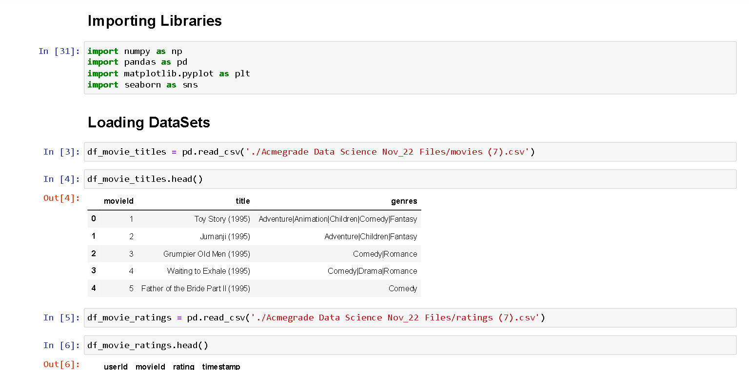
Project Code Snapshots

Slide 9
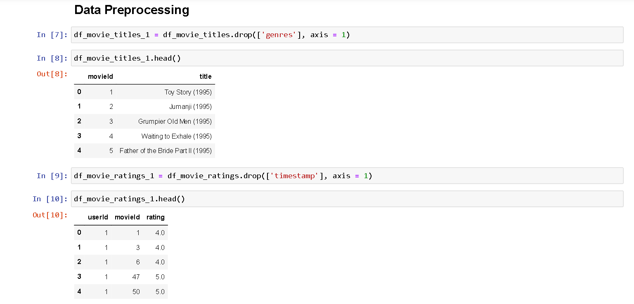

Slide 10
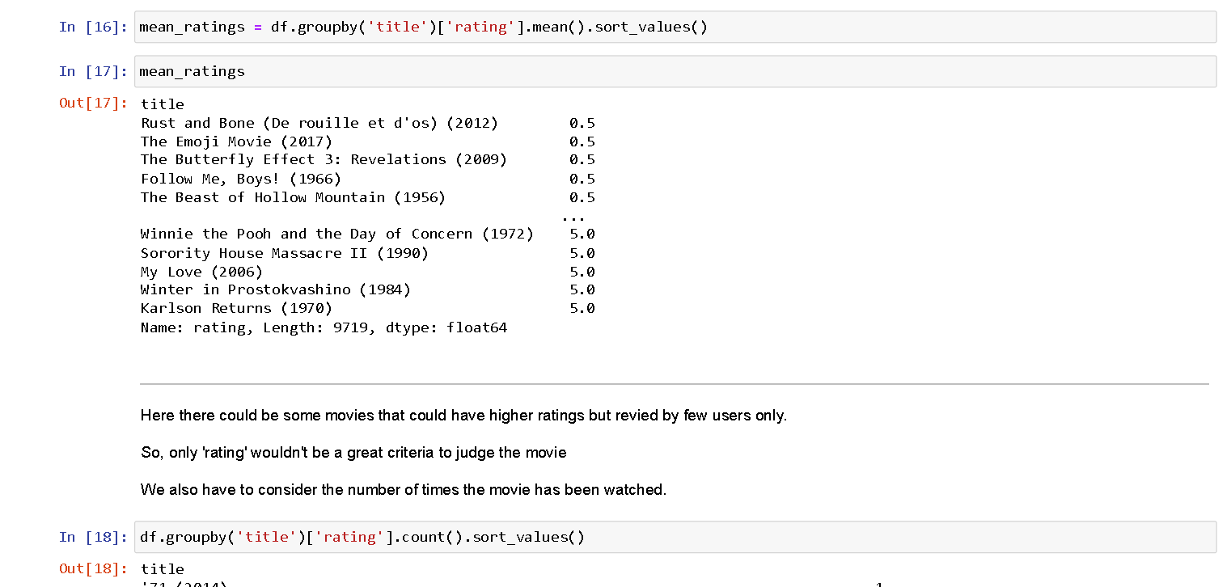

Slide 11
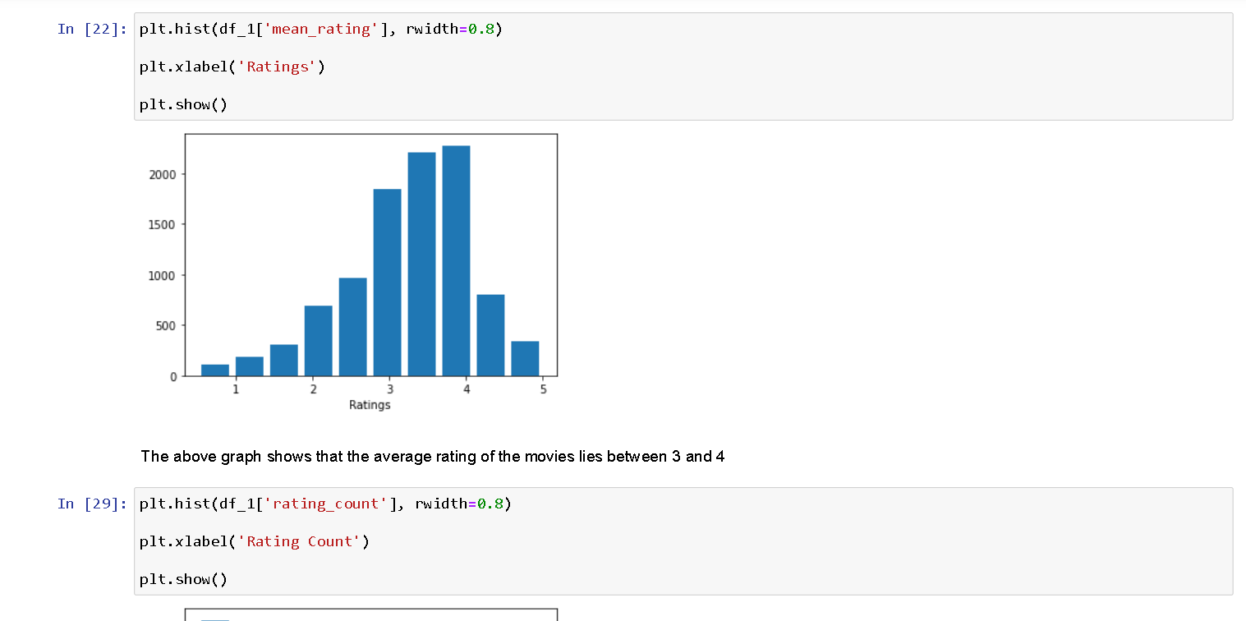

Slide 12
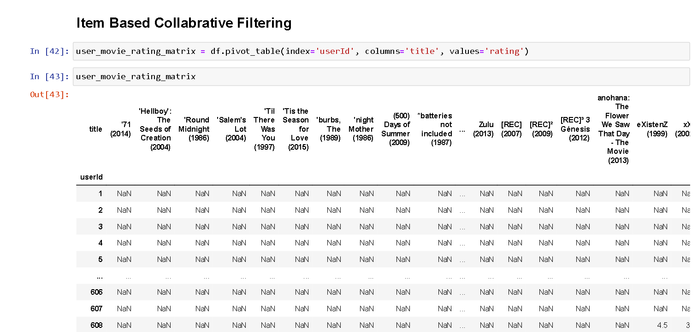

Slide 13
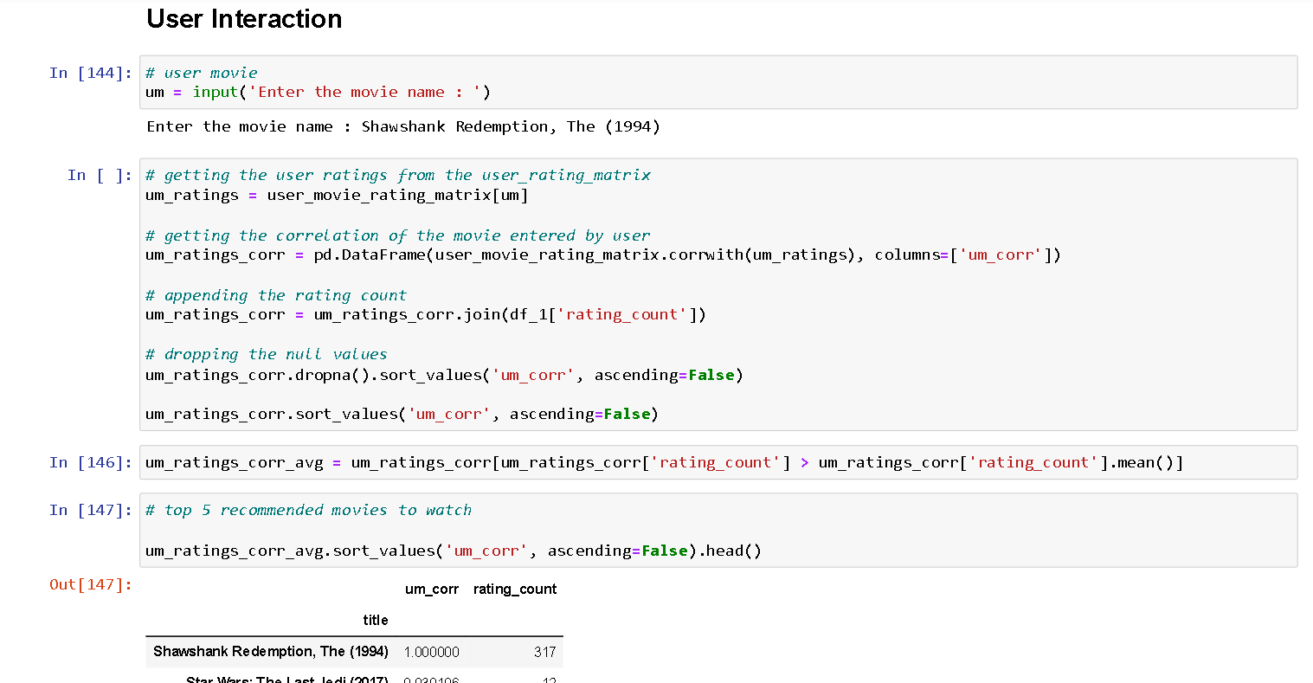

Slide 14
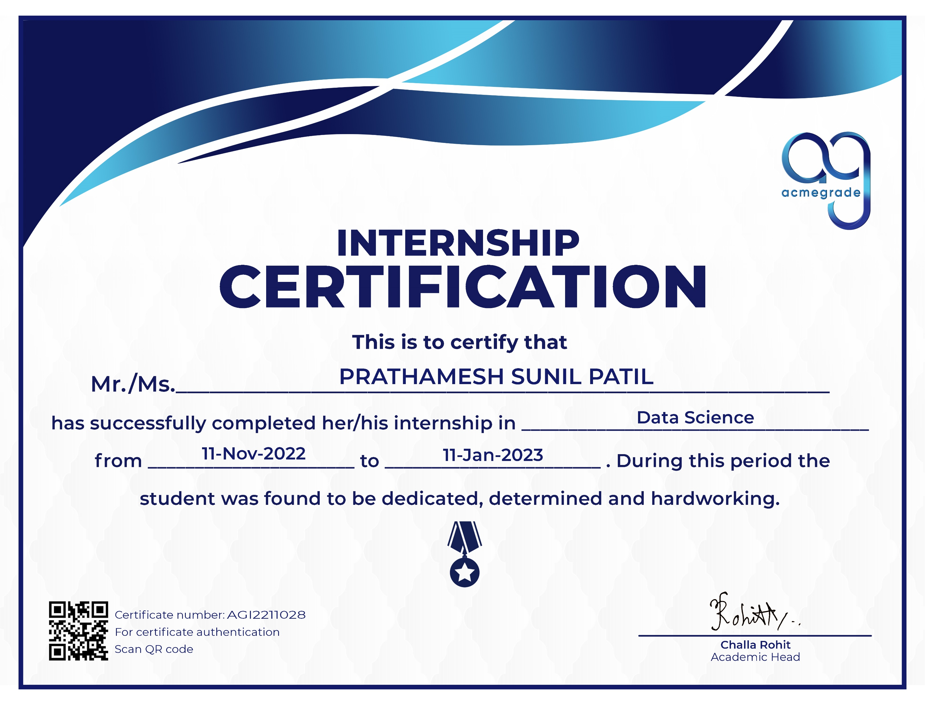
Certificate

Slide 15
Experience and Knowledge Gain
I learned a lot of things from this internship.
Got a brief idea about how a project goes from raw data – processing – useful data – results.
Engaged with technologies that are required for building such cool projects and applying them to real world scenarios.

Slide 16
Conclusion
This software internship program was aimed at providing an experience in Python Programming.
It was directed towards enhancing the knowledge about current as well as upcoming technologies and how they are actually used.
The project developed was a part of the internship project in Data Science Training.

Slide 17
Thank You !

